Slide 1
Decision Science for Sustainable Livestock Systems
Yalong Pi
Associate Research Scientist
Texas A&M Institute of Data Science
piyalong@tamu.edu
20250327

Slide 2
Agenda
Fundamentals of machine learning
Feed grading with computer vision
Transformers for Language Models (GPT)

Slide 3
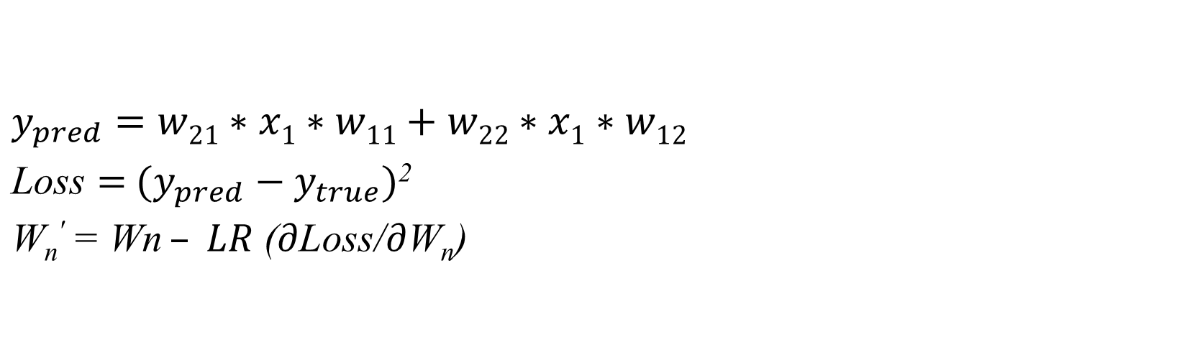
f(i₁)
w₁₁
x₁
w₂₁
y
w₂₂
f(i₂)
w₁₂
$y_{pred}$ $=w21∗x1∗w11+w22∗x1∗w12$ $\text{Loss}={ (y_{pred}−y}_{true})$² $$\text{W}\text{n}\text{′} \text{= }\text{Wn} – LR \text{(}∂\text{Loss}\text{/}∂\text{W}\text{n}\text{)}$$
x | y
1 | 10
2 | 20
5 | 30

Slide 4
$y_{pred}$ $=w21∗x1∗w11+w22∗x1∗w12$ $\text{Loss}={ (y_{pred}−y}_{true})$² $$\text{W}\text{n}\text{′} \text{= }\text{Wn} – LR \text{(}∂\text{Loss}\text{/}∂\text{W}\text{n}\text{)}$$
x | y
1 | 10
2 | 20
5 | 30

Slide 5
$y_{pred}$ $=w21∗x1∗w11+w22∗x1∗w12$ $\text{Loss}={ (y_{pred}−y}_{true})$² $$\text{W}\text{n}\text{′} \text{= }\text{Wn} – LR \text{(}∂\text{Loss}\text{/}∂\text{W}\text{n}\text{)}$$
x | y
1 | 10
2 | 20
5 | 30

Slide 6
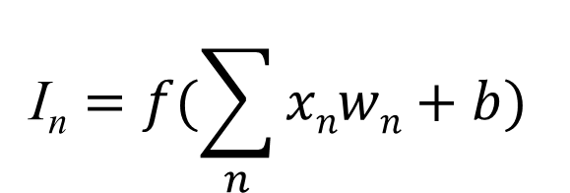
i₁
w₁
For each connection:
x₁
i₂
w₂
$$\text{I}\text{n}=f(\sum_{n}{xnwn+b})$$
y₁
x₂
y₂
f is the activation function
w_{n} is the weight
b is the bias.
A DNN has millions of weights and biases
w_{n}
i_{n}

Slide 7
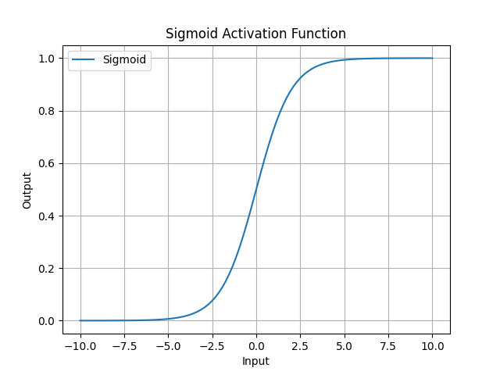
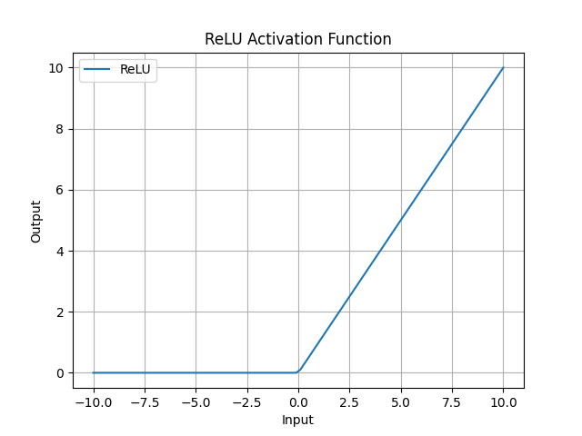
Activation Functions

Slide 8
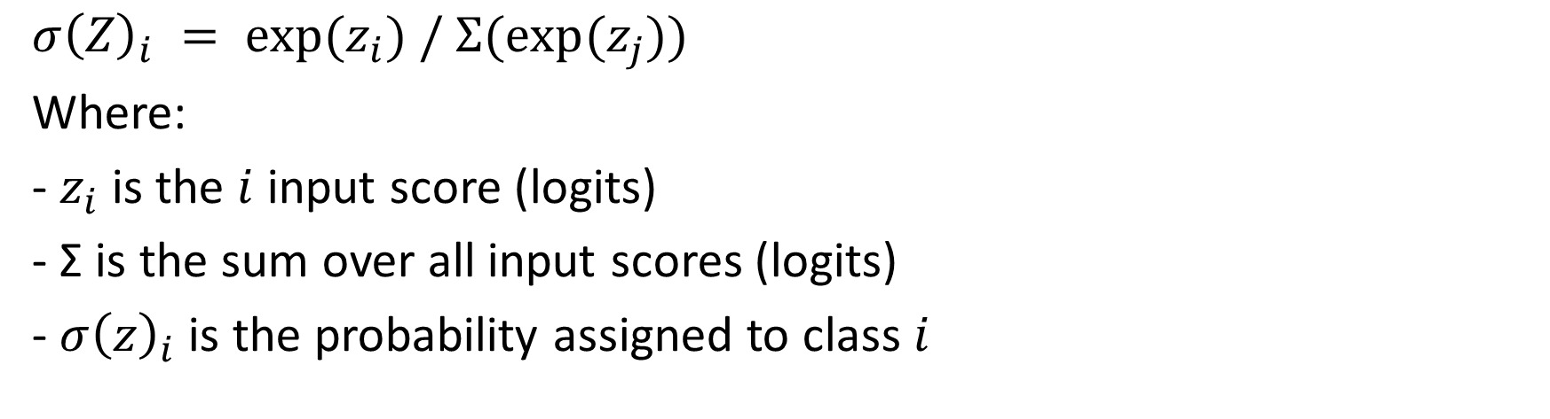
Softmax
$$σ{\left(Z\right)}_{i} = exp⁡(z_{i}) / Σ(exp⁡(z_{j}))$$
Where:
- $z_{i}$ is the $i$ input score (logits)
- Σ is the sum over all input scores (logits)
- $σ{\left(z\right)}_{i}$is the probability assigned to class $i$
Example:
[-0.37, -1.06, -0.07, -1.47, -0.90] -> [0.265, 0.133, 0.358, 0.088, 0.155]

Slide 9
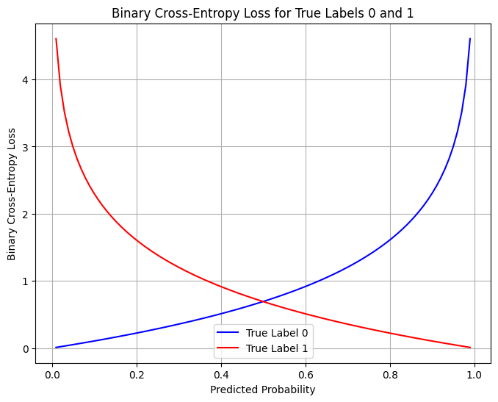
Binary cross entropy

Slide 10
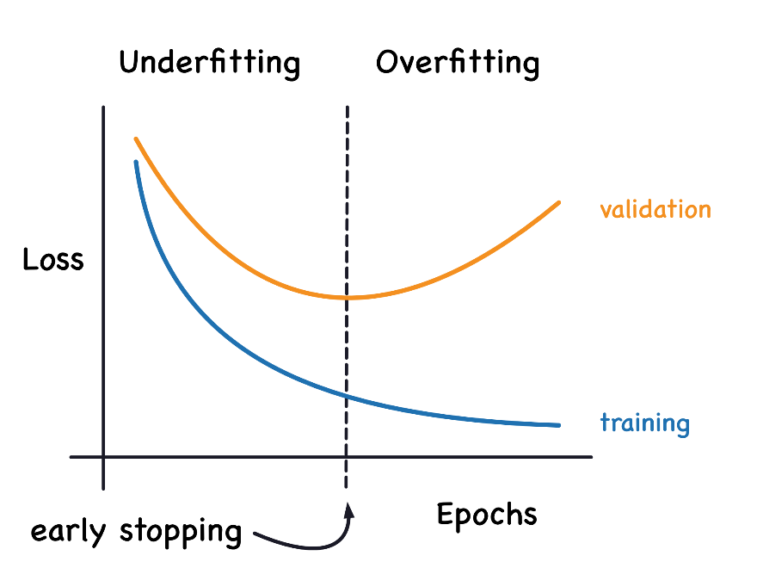

Slide 11
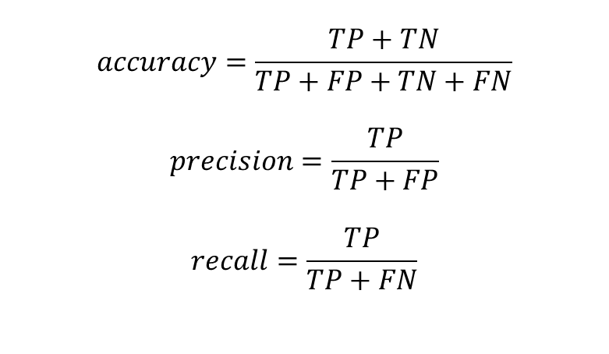
Prediction\Ground Truth | Positive | Negative
Positive | TP | FP
Negative | FN | TN
$$accuracy=\frac{TP+TN}{TP+FP+TN+FN}$$
$$precision=\frac{TP}{TP+FP}$$
$$recall=\frac{TP}{TP+FN}$$

Slide 12
Computer vision

Slide 13
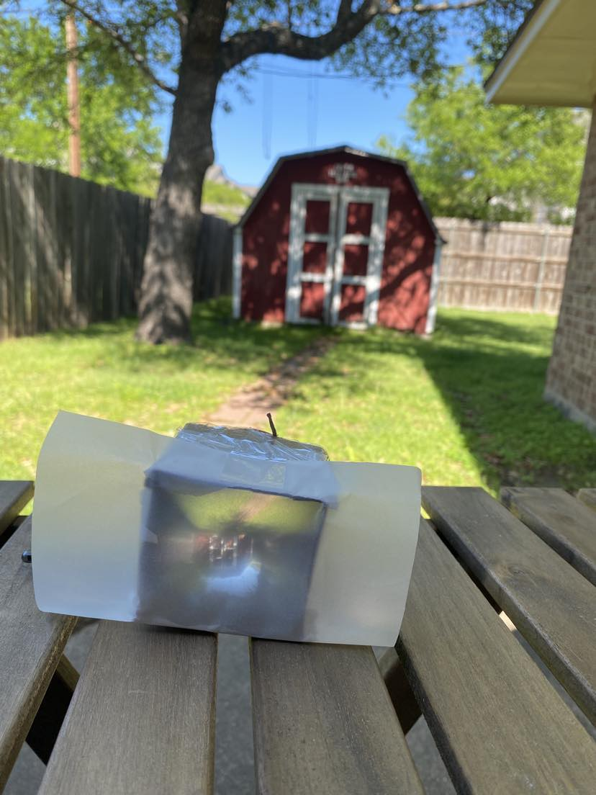
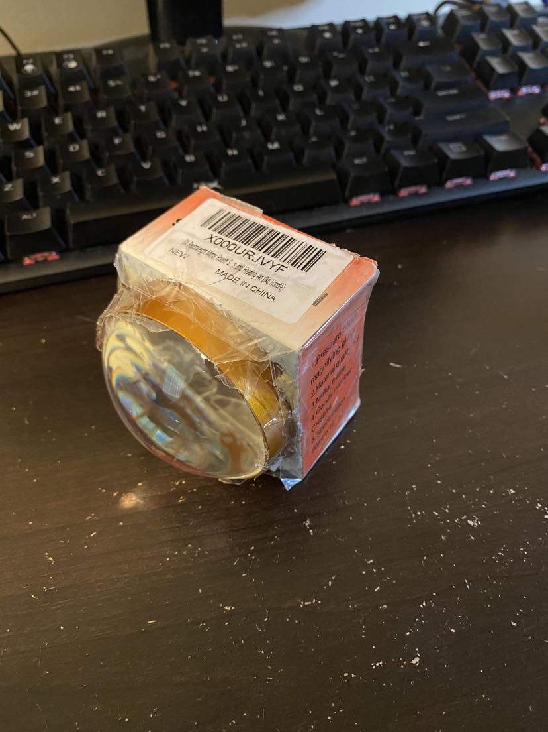

Slide 14
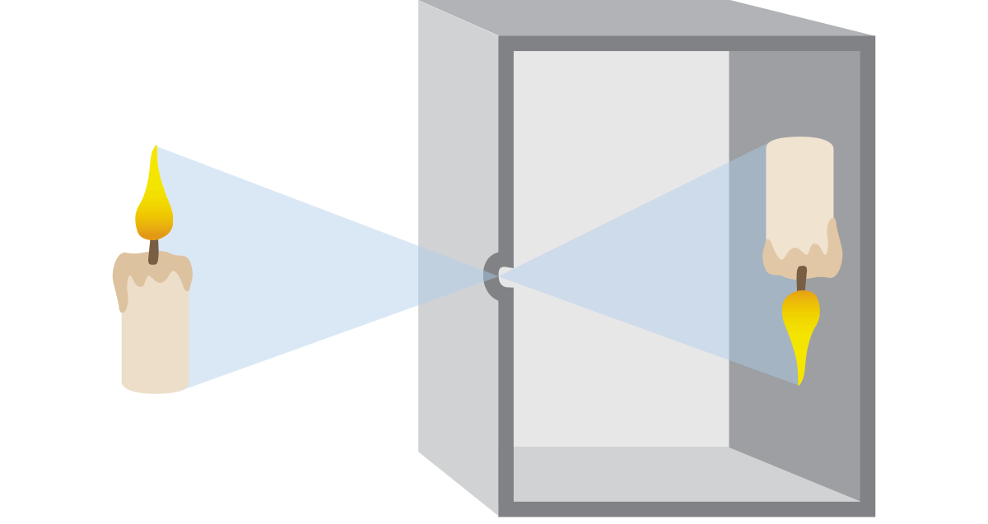
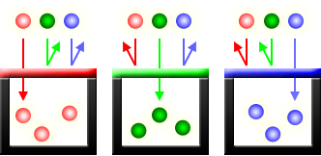
Pinhole principle
Traditional film
Digital sensors (CCD and CMOS)
Red Green Blue (RGB) channels

Slide 15
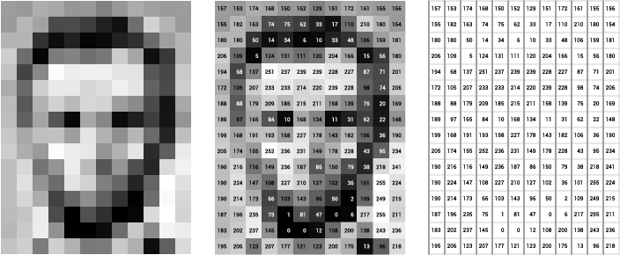
Grey Scale

Slide 16

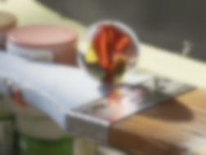
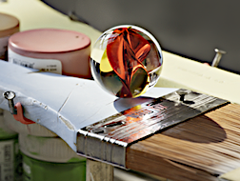
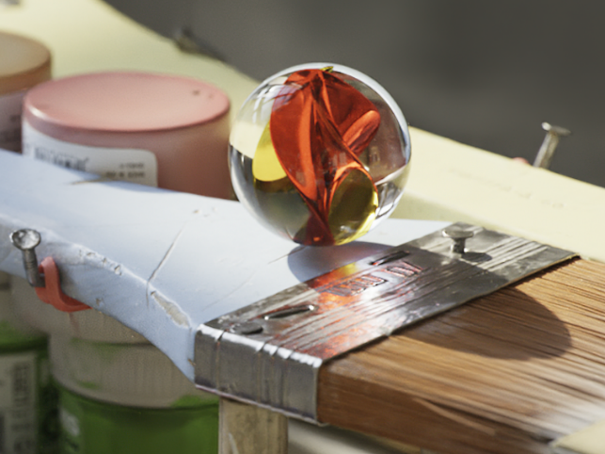

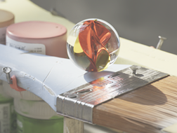

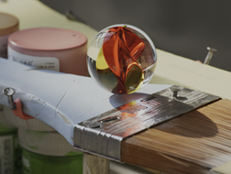
Kernels and Convolution
Blur
Sharpen
Brighten
Darken
Original Image
Notes:
Before we get into neural networks, lets talk about how Computer Vision experts used to approach this type of problem. If you played with Photoshop, MS Paint, or GIMP a lot as a kid making .gifs or memes or stilly pictures: good news! Understanding how computers represent and manipulate photos is a great foundation for modern day computer vision.
For example, let’s look at the blur, sharpen, brighten and darken tools. In a drawing program, the area around where we click that manipulates our image is called the kernel. Convolution is when our kernel is multiplied with our image, and that is what’s happening when we select these tools and drag it across our image. To be technical, convolution is when we apply one function to another function, but we can think of our base image as a function of color, and our kernel as a function of pixels.

Slide 17
Kernels and Convolution
Blur
.06 | .13 | .06
.13 | .25 | .13
.06 | .13 | .06
Sharpen
0 | -1 | 0
-1 | 5 | -1
0 | -1 | 0
Brighten
0 | 0 | 0
0 | 1.5 | 0
0 | 0 | 0
Darken
0 | 0 | 0
0 | 0.5 | 0
0 | 0 | 0
Original Image
Notes:
The kernel is just a small matrix, blurring is a weighted averaging of the numbers that represent the pixels. Sharpen brightens the pixel in the center of it, but subtracts the pixels directly adjacent to it. Brighten makes the center pixel’s color values bigger (if 255 is white) or smaller (if 0 is white). Darken does the opposite. Let’s take a look at a smaller image and break it down.

Slide 18

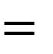
Kernels and Convolution
Blur Kernel
Original Image
Convolved Image
1 | 0 | 1 | 1 | 0 | 1
0 | 1 | 0 | 0 | 1 | 0
0 | 1 | 1 | 1 | 1 | 0
0 | 1 | 1 | 1 | 1 | 0
1 | 0 | 1 | 1 | 0 | 1
1 | 1 | 0 | 0 | 1 | 1
.06 | .13 | .06
.13 | .25 | .13
.06 | .13 | .06
$$∗$$
$$=$$
Notes:
Ok, we have a picture of a heart. Not obvious? Sorry, only had 6 x 6 pixels to work with.
We’re going to step through a convolution. The fancy star in the center is the convolution operator. The resulting image is going to be 4 x 4. It’ll be more obvious in a bit.

Slide 19
Kernels and Convolution
Blur Kernel
Original Image
Convolved Image
1 | 0 | 1 | 1 | 0 | 1
0 | 1 | 0 | 0 | 1 | 0
0 | 1 | 1 | 1 | 1 | 0
0 | 1 | 1 | 1 | 1 | 0
1 | 0 | 1 | 1 | 0 | 1
1 | 1 | 0 | 0 | 1 | 1
.06 | .13 | .06
.13 | .25 | .13
.06 | .13 | .06
$$∗$$
$$=$$
Notes:
Let’s start in the top left corner. We call the section that we’re about to convolve, the red box here, the window. Notice how it has the same shape as our kernel.

Slide 20
Kernels and Convolution
Blur Kernel
Original Image
Convolved Image
1 | 0 | 1 | 1 | 0 | 1
0 | 1 | 0 | 0 | 1 | 0
0 | 1 | 1 | 1 | 1 | 0
0 | 1 | 1 | 1 | 1 | 0
1 | 0 | 1 | 1 | 0 | 1
1 | 1 | 0 | 0 | 1 | 1
Multiply
.06 | 0 | .06
0 | .25 | 0
0 | .13 | .06
.06 | .13 | .06
.13 | .25 | .13
.06 | .13 | .06
$$∗$$
$$=$$
Notes:
We’re going to take our kernel and multiply each cell in the kernel with the respective cell in the window.

Slide 21
Kernels and Convolution
Blur Kernel
Original Image
Convolved Image
1 | 0 | 1 | 1 | 0 | 1
0 | 1 | 0 | 0 | 1 | 0
0 | 1 | 1 | 1 | 1 | 0
0 | 1 | 1 | 1 | 1 | 0
1 | 0 | 1 | 1 | 0 | 1
1 | 1 | 0 | 0 | 1 | 1
.06 | 0 | .06
0 | .25 | 0
0 | .13 | .06
.56
.06 | .13 | .06
.13 | .25 | .13
.06 | .13 | .06
$$∗$$
$$=$$
Total
Notes:
We’re then going to total the results of that multiplication

Slide 22
Kernels and Convolution
Blur Kernel
Original Image
Convolved Image
1 | 0 | 1 | 1 | 0 | 1
0 | 1 | 0 | 0 | 1 | 0
0 | 1 | 1 | 1 | 1 | 0
0 | 1 | 1 | 1 | 1 | 0
1 | 0 | 1 | 1 | 0 | 1
1 | 1 | 0 | 0 | 1 | 1
0 | .13 | .06
.13 | 0 | 0
.06 | .13 | .06
.56 | .57
.06 | .13 | .06
.13 | .25 | .13
.06 | .13 | .06
$$∗$$
$$=$$
Notes:
Next, we move or window over by 1…

Slide 23
Kernels and Convolution
Blur Kernel
Original Image
Convolved Image
1 | 0 | 1 | 1 | 0 | 1
0 | 1 | 0 | 0 | 1 | 0
0 | 1 | 1 | 1 | 1 | 0
0 | 1 | 1 | 1 | 1 | 0
1 | 0 | 1 | 1 | 0 | 1
1 | 1 | 0 | 0 | 1 | 1
.56 | .57 | .57 | .56
.7 | .82 | .82 | .7
.69 | .95 | .95 | .69
.64 | .69 | .69 | .64
.06 | .13 | .06
.13 | .25 | .13
.06 | .13 | .06
$$∗$$
$$=$$
Notes:
.. and we repeat the process until we’ve calculated the convolution for the whole image.
https://mathworld.wolfram.com/Convolution.html

Slide 24
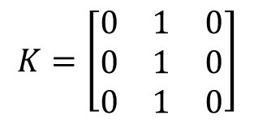
Convolution Computation
7 | 7 | 7 | 7 | 5
7 | 7 | 7 | 5 | 5
7 | 7 | 5 | 5 | 5
7 | 5 | 5 | 5 | 5
5 | 5 | 5 | 5 | 5
7 | 7 | 7 | 7 | 5
7 | 7 | 7 | 5 | 5
7 | 7 | 5 | 5 | 5
7 | 5 | 5 | 5 | 5
5 | 5 | 5 | 5 | 5
7 | 7 | 7 | 7 | 5
7 | 7 | 7 | 5 | 5
7 | 7 | 5 | 5 | 5
7 | 5 | 5 | 5 | 5
5 | 5 | 5 | 5 | 5
$$K=\left[\begin{matrix}0 & 1 & 0 \\ 0 & 1 & 0 \\ 0 & 1 & 0\end{matrix}\right]$$
0 | 0 | 0 | 0 | 0
0 | 21 | 19 | 17 | 0
0 | 19 | 17 | 15 | 0
0 | 17 | 15 | 15 | 0
0 | 0 | 0 | 0 | 0
Kernel at position 1
Kernel at position 2
Kernel at position n

Slide 25
Convolution Computation for more than one dimension
Kernel size: 3x3x4
0 | 0 | 0 | 0 | 0
0 | 21 | 19 | 17 | 0
0 | 19 | 17 | 15 | 0
0 | 17 | 15 | 15 | 0
0 | 0 | 0 | 0 | 0
0 | 0 | 0 | 0 | 0
0 | 21 | 19 | 17 | 0
0 | 19 | 17 | 15 | 0
0 | 17 | 15 | 15 | 0
0 | 0 | 0 | 0 | 0
Kernel size: 3x3x4

Slide 26
STRIDE
Stride 1
1 | 0 | 1 | 1 | 0 | 1
0 | 1 | 0 | 0 | 1 | 0
0 | 1 | 1 | 1 | 1 | 0
1 | 0 | 1 | 1 | 0 | 1
0 | 1 | 0 | 0 | 1 | 0
0 | 1 | 1 | 1 | 1 | 0
.56 | .57 | .57 | .56
Stride 2
1 | 0 | 1 | 1 | 0 | 1
0 | 1 | 0 | 0 | 1 | 0
0 | 1 | 1 | 1 | 1 | 0
1 | 0 | 1 | 1 | 0 | 1
0 | 1 | 0 | 0 | 1 | 0
0 | 1 | 1 | 1 | 1 | 0
.56 | .57
Stride 3
1 | 0 | 1 | 1 | 0 | 1
0 | 1 | 0 | 0 | 1 | 0
0 | 1 | 1 | 1 | 1 | 0
1 | 0 | 1 | 1 | 0 | 1
0 | 1 | 0 | 0 | 1 | 0
0 | 1 | 1 | 1 | 1 | 0
.56 | .56
Notes:
There are a few parameters we can play with for convolution. One is stride, which is by how many cells should we move our window by when doing convolution. Let’s chop our heart in half to see what we mean. Oh no, broken heart!
Let’s assume we had the same kernel as before.
With a stride of 2, we skip starting convolution at every other column and every other row. When we do this, we also generate less data, which has pros and cons. The good is that means we have less data to analyze, but if we increase our stride too much, we might miss important information.
The other thing to look for is with a stride of 2, we don’t have enough columns to do a convolution for the right side our image.

Slide 27
Padding
Original Image
Zero Padding
0 | 0 | 0 | 0 | 0 | 0 | 0 | 0
0 | 1 | 0 | 1 | 1 | 0 | 1 | 0
0 | 0 | 1 | 0 | 0 | 1 | 0 | 0
0 | 0 | 1 | 1 | 1 | 1 | 0 | 0
0 | 0 | 1 | 1 | 1 | 1 | 0 | 0
0 | 1 | 0 | 1 | 1 | 0 | 1 | 0
0 | 1 | 1 | 0 | 0 | 1 | 1 | 0
0 | 0 | 0 | 0 | 0 | 0 | 0 | 0
1 | 0 | 1 | 1 | 0 | 1
0 | 1 | 0 | 0 | 1 | 0
0 | 1 | 1 | 1 | 1 | 0
0 | 1 | 1 | 1 | 1 | 0
1 | 0 | 1 | 1 | 0 | 1
1 | 1 | 0 | 0 | 1 | 1
Notes:
If we want enough data to make sure all pixels are used in convolution, or if we want the resulting image to be the same size as our input image, we can do something called padding. A quick and easy way to do this is called “zero” padding, where we add a border of zeros around our image. This can be sufficient in many cases, but in some where the image is small, it can have an impact on the convolution.
https://setosa.io/ev/image-kernels/
https://glassboxmedicine.com/2019/04/13/a-short-history-of-convolutional-neural-networks/

Slide 28
Padding
Original Image
Mirror Padding
1 | 1 | 0 | 1 | 1 | 0 | 1 | 1
1 | 1 | 0 | 1 | 1 | 0 | 1 | 1
0 | 0 | 1 | 0 | 0 | 1 | 0 | 0
0 | 0 | 1 | 1 | 1 | 1 | 0 | 0
0 | 0 | 1 | 1 | 1 | 1 | 0 | 0
1 | 1 | 0 | 1 | 1 | 0 | 1 | 1
1 | 1 | 1 | 0 | 0 | 1 | 1 | 1
1 | 1 | 1 | 0 | 0 | 1 | 1 | 1
1 | 0 | 1 | 1 | 0 | 1
0 | 1 | 0 | 0 | 1 | 0
0 | 1 | 1 | 1 | 1 | 0
0 | 1 | 1 | 1 | 1 | 0
1 | 0 | 1 | 1 | 0 | 1
1 | 1 | 0 | 0 | 1 | 1
Notes:
There are many other types of padding too. Many frameworks have “mirror padding” that instead duplicates the top and bottom rows, and the left and right columns.

Slide 29
Kernels and Neural Networks
Kernel
w₁ | w₂ | w₃
w₄ | w₅ | w₆
w₇ | w₈ | w₉
Notes:
So before neural networks, computer vision researchers would play around with the numbers within a kernel to see if it can be used to find any interesting features in images. So far, we’ve only used 3 x 3 kernels, but they can be any size, and researchers would try to do things like make a kernel that returned a high value if it convolved a cat ear. So, you could have a cat ear kernel, a cat nose kernel, a cat eye kernel, and if you ran all those through an image and found matches, you might guess there was a cat!
But as neural networks got more and more powerful, people made the connection that, woah. Kernels are these devices that multiply weights to an input, and then adds the results together. What else does that?

Slide 30
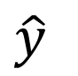
Kernels and Neural Networks
Kernel
Neuron
x₁
x₂
w₂
w₃
w₁ | w₂ | w₃
w₄ | w₅ | w₆
w₇ | w₈ | w₉
w₁
w₄
w₅
w₆
$$\hat{y}$$
Notes:
Oh yeah, neurons do that too! That’s exactly what Convolutional Neural Networks are. They map the inputs of a neuron to a kernel with trainable weights.
Interesting history: https://glassboxmedicine.com/2019/04/13/a-short-history-of-convolutional-neural-networks/
How backpropagation works for CNNs: https://www.jefkine.com/general/2016/09/05/backpropagation-in-convolutional-neural-networks/

Slide 31
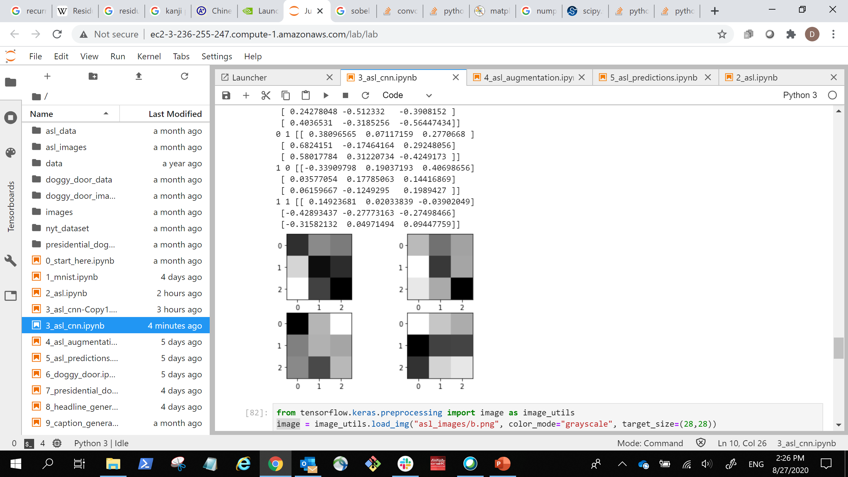
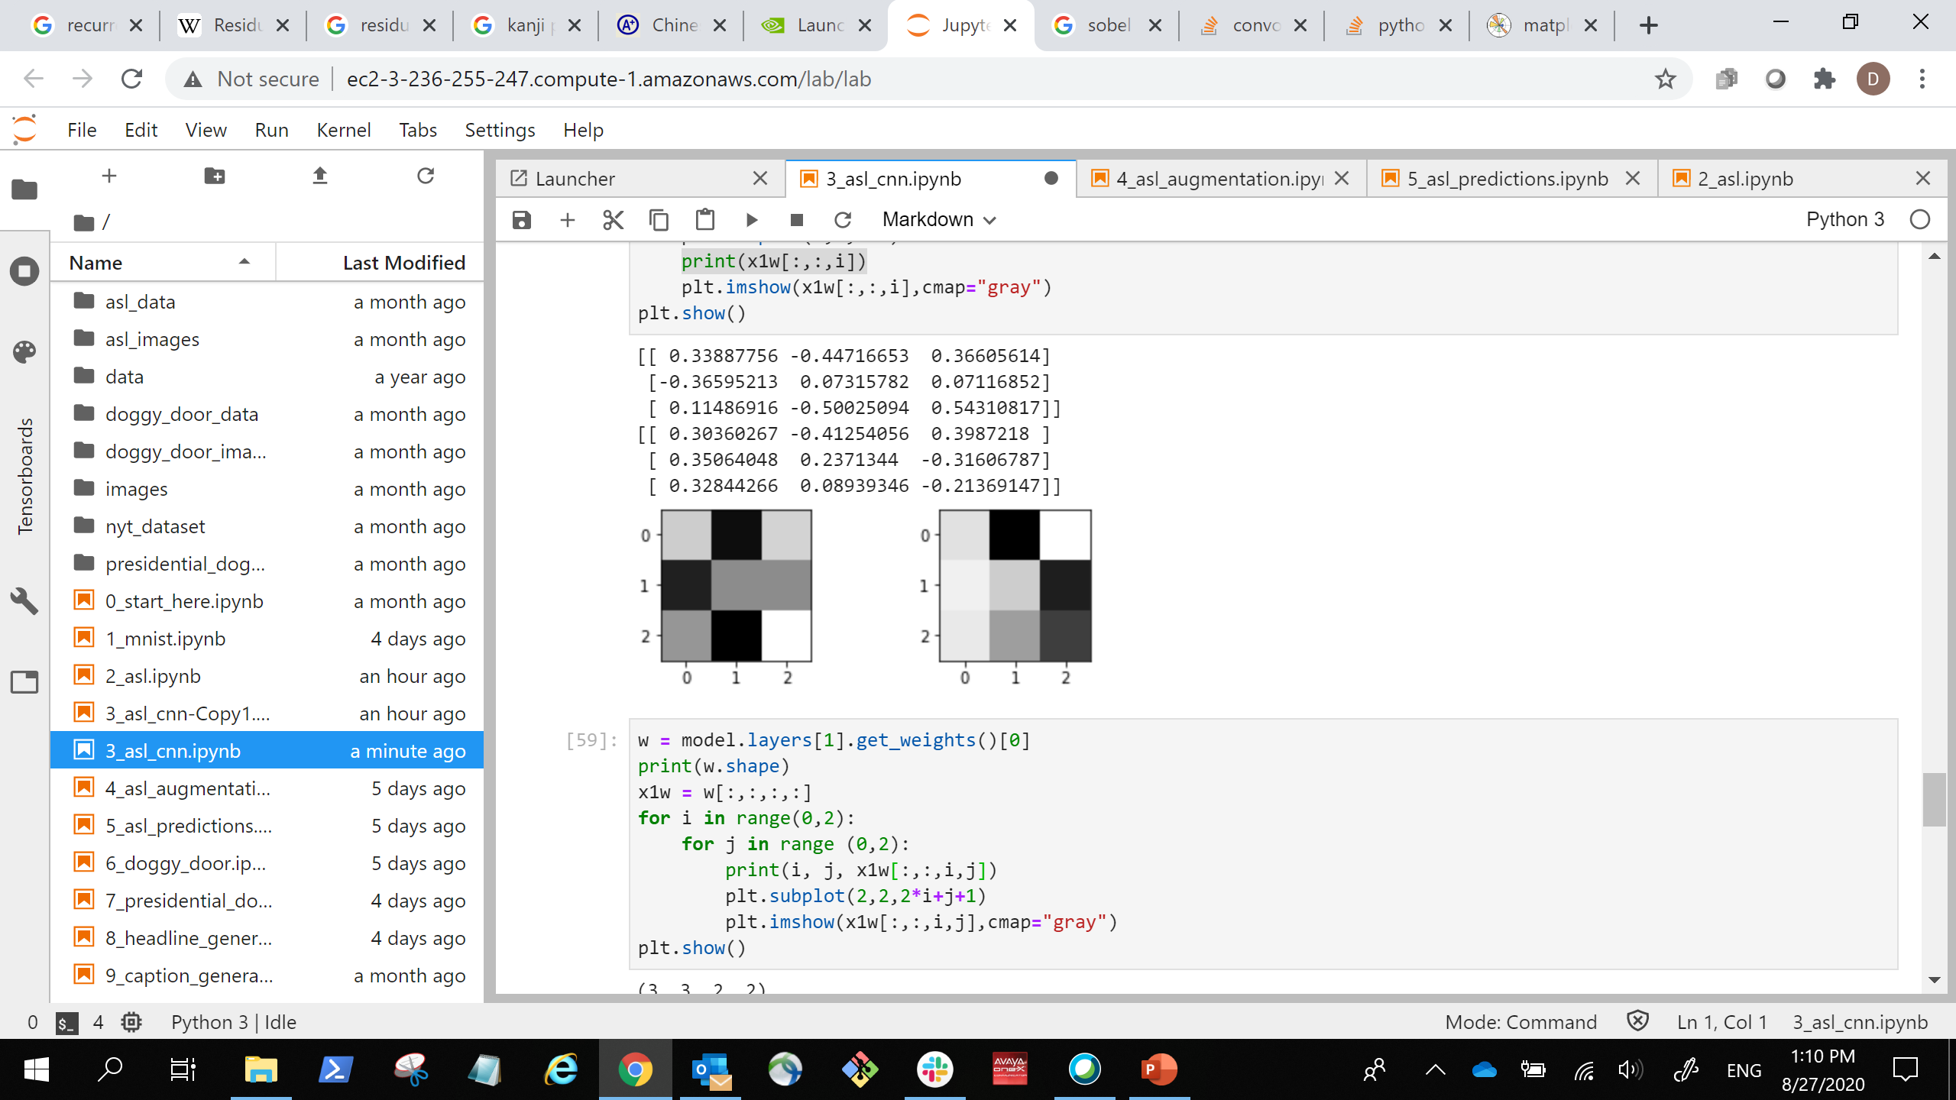
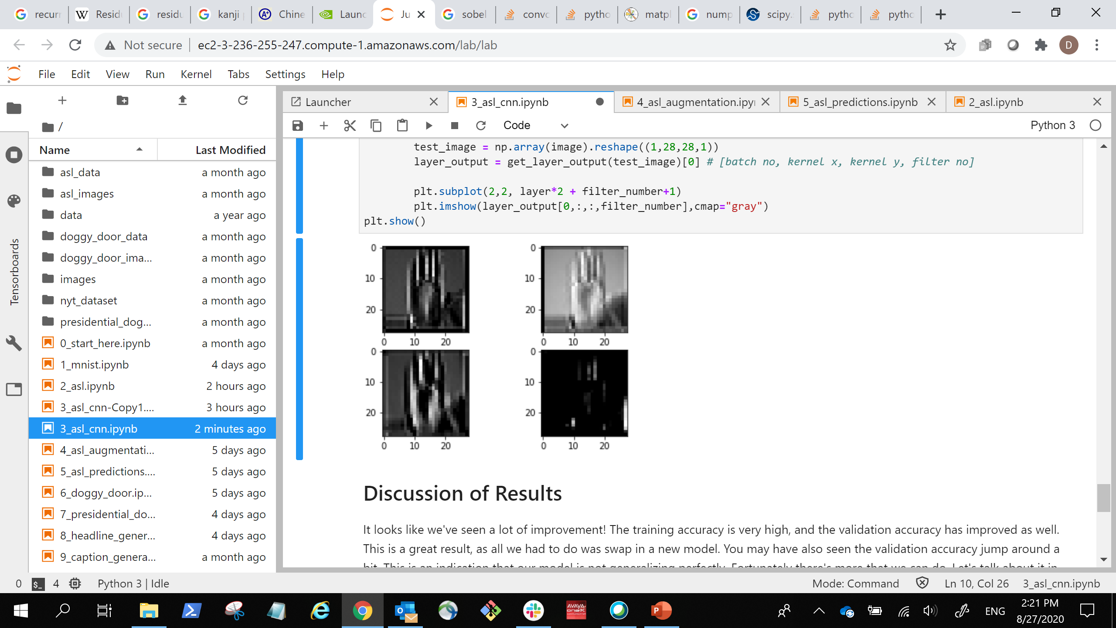
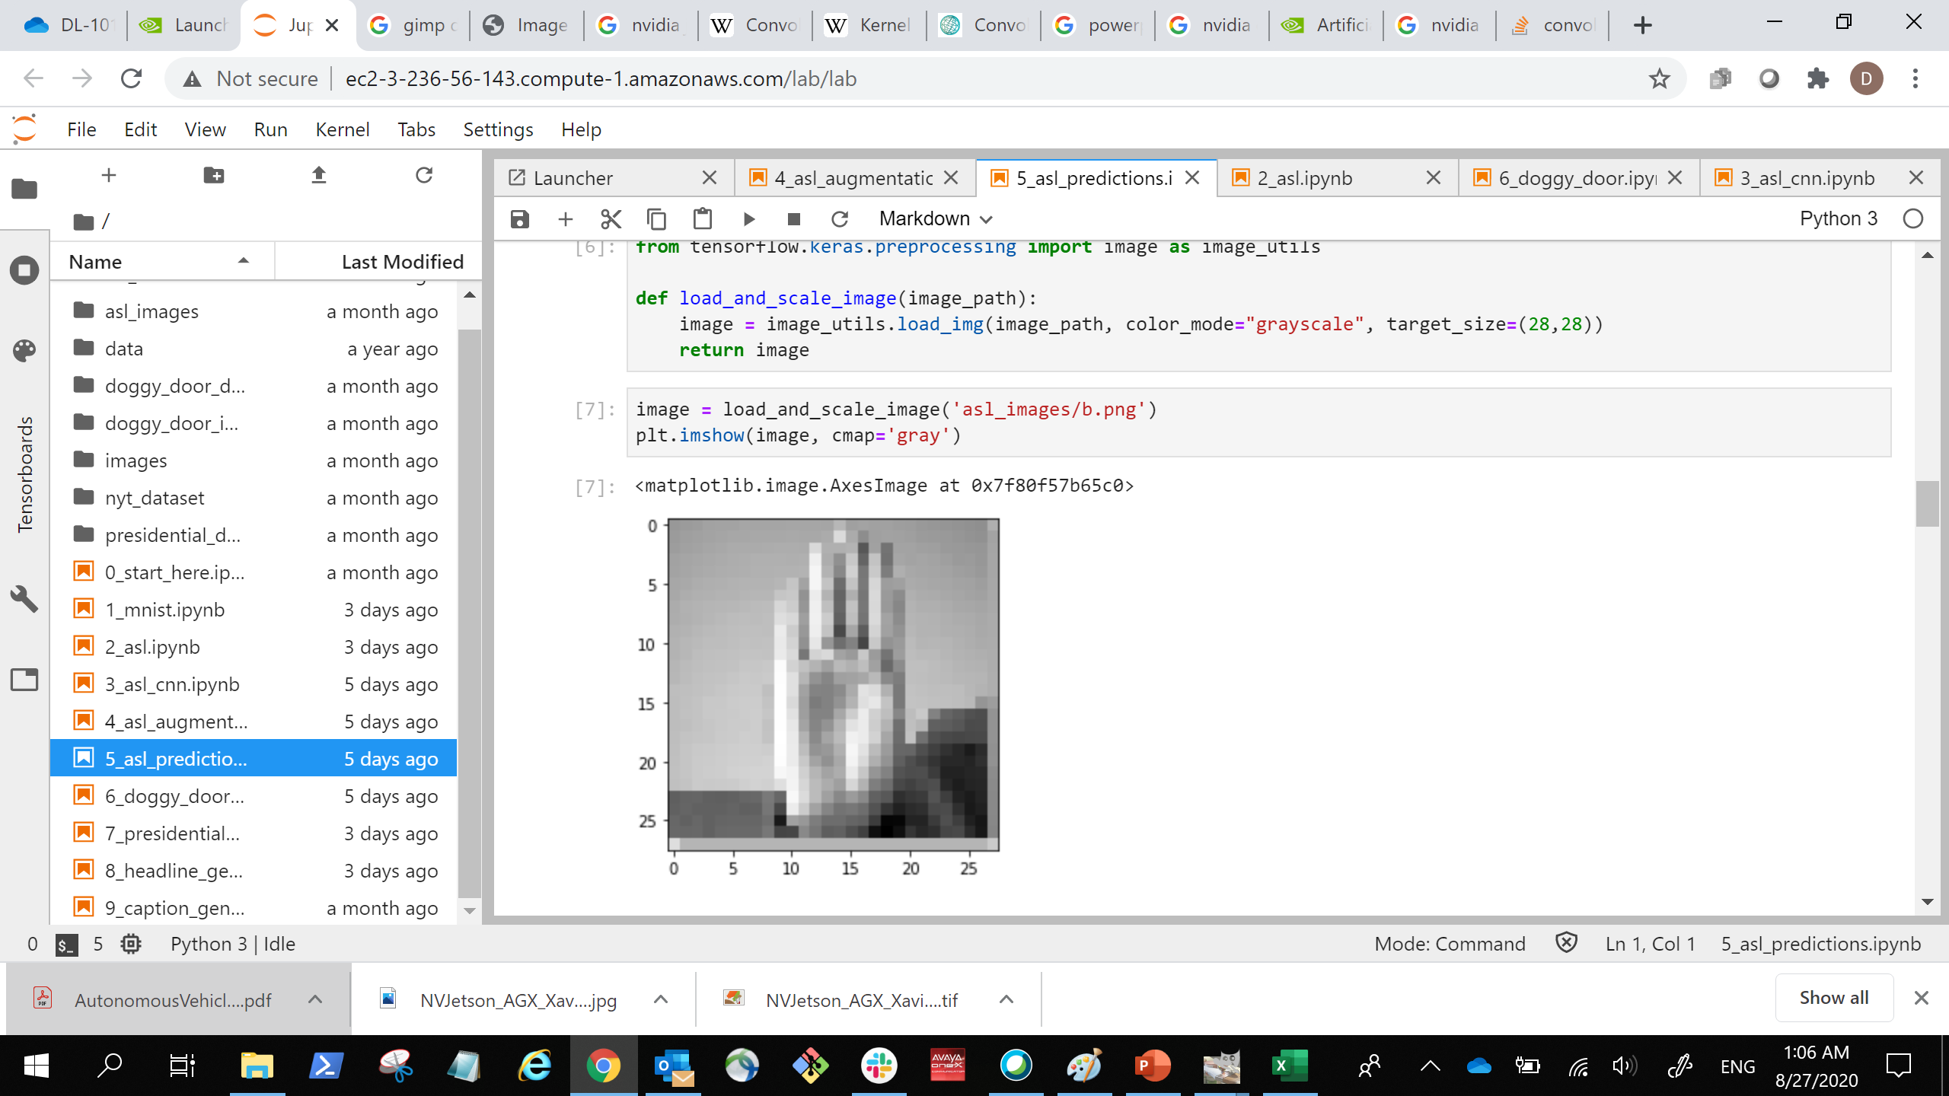
Kernels and Neural Networks
… …
… …
(28, 28, 2)
Stacked Images
(28, 28, 2)
Stacked Images
(3, 3, 1, 2)
Kernels
(3, 3, 2, 2)
Kernels
(512)
Dense
(512)
Dense
(28, 28, 1)
Image Input
(1568)
Flattened Image
Vector
(24)
Output Prediction
Notes:
This is our new neural network architecture. This is a bit smaller than what we’ll do in the lab, but the structure is similar. First, we have our input image. We’re going to start with a variable number of convolutional layers (in this case 2 3x3x1 greyscale filters). We can have as many as we want, and each one of them is going to produce a new image by trying to extract interesting features out of the original image.
We’re then going to stack these images on top of each other, so we end up with a three-dimensional image, but not 3d in the way that humans perceive it. We can then send this new image through a new set of filters. When convolving, even though we’re technically doing a 2D convolution because we’re in black and white, we’re actually convolving a 3D object that is our window size by the number of stacked images. Because we have two stacked images, our kernels are digesting a 3x3x2 slice of the stacked images. In the picture above, we have 2 3x3x2 filters.
When we’re done convolving, we’ll flatten everything out, and feed the results through our neural net as normal.
It used to be that data scientists would toy around with the kernel sizes more, and that’s still useful in some cases, but empirically, sticking with 3x3 works well. Let’s go back to computer vision theory to understand why.
Great stack overflow on how to visualize kernels: https://stackoverflow.com/questions/43305891/how-to-correctly-get-layer-weights-from-conv2d-in-keras
Another stack overflow on the dimensions of the kernels: https://stackoverflow.com/questions/46480699/why-are-my-keras-conv2d-kernels-3-dimensional#:~:text=I%20understand%20the%20mechanics%20of,kernels%20of%20size(7x7x8).
A more advanced topic, but here we’re doing conventional convolution, but there are many ways to do it.
An article diving into the different types: https://towardsdatascience.com/a-comprehensive-introduction-to-different-types-of-convolutions-in-deep-learning-669281e58215
An article explaining the math: http://d2l.ai/chapter_convolutional-neural-networks/channels.html

Slide 32
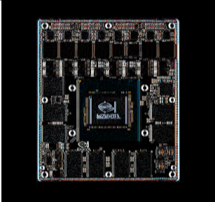
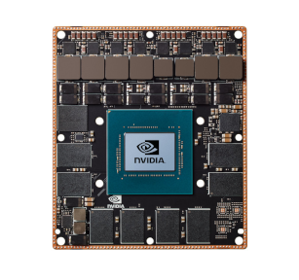
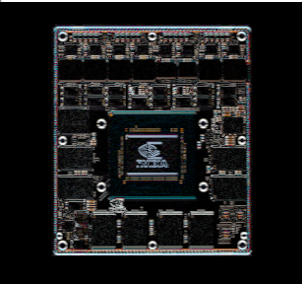
Finding Edges
Vertical Edges
Original Image
Horizontal Edges
1 | 0 | -1
2 | 0 | -2
1 | 0 | -1
0 | 0 | 0
0 | 1 | 0
0 | 0 | 0
1 | 2 | 1
0 | 0 | 0
-1 | -2 | -1
Notes:
So when researchers first came up with these kernels before neural networks, they also realized that you can use them to essentially calculate the derivative of these images. What in the world does that mean? Well there is a special class of kernels that can pick up edges, places where the change in color of an image is changing rapidly. For instance, the kernel on the left picks ups vertical edges and the kernel on the right picks up horizontal edges
(notice how the horizontal lines are gone in the left? That’s because if there’s a horizontal line, there’s no horizontal change).
By combining the information from both the horizontal and vertical changes, bam! We now have a direction of change for each point. (Ever thought of where the term “Color Gradient” comes from?)
We can do some cool things with this information, like be able to identify any circles in our image (like our marble from earlier), but rather than figure out the fancy math for this ourselves, we’ll let the neural network do it.
Here’s a great demo website showing these concepts in action: https://setosa.io/ev/image-kernels/

Slide 33
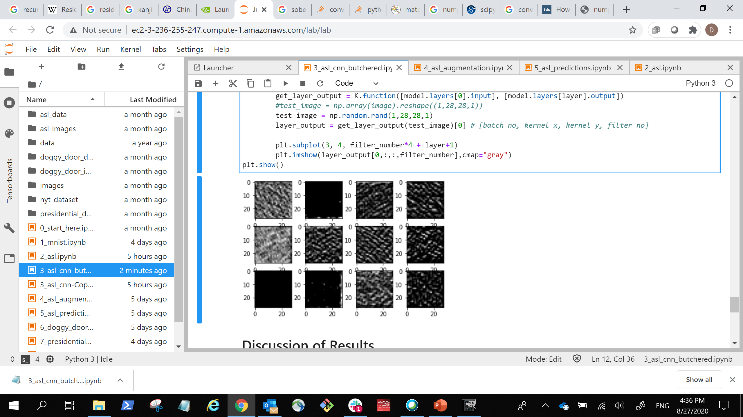
Neural Network Perception
Input
Convolution
Convolution
Convolution
Convolution
Dense
Dense
Output
Edges
Textures
Objects
Notes:
So if we’re willing to get weird for a second, the way artificial neural work is very similar to how our own brains processes images. Both our brain and the artificial brain will take the edge detectors and feed the results into the next layer which will detect intersections between edges and will be good at detecting textures and patterns. Those feed into the next layer and next layer, becoming more and more developed until entire objects can be recognized.
Here is the result of using four layers of three neurons each on our ASL dataset. Nothing too fancy here because our images are small …

Slide 34
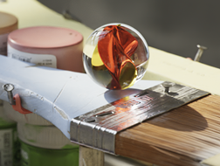

Neural Network Perception
Notes:
… so I also ran our marble through https://deepdreamgenerator.com/, which is built using a much larger network on plenty of high-resolution photos of many types of objects. It will enhance the patterns or objects it’s able to detect. Any interpretation here is trying to mind read an artificial intelligence, which is as unscientific as it sounds, but I can almost make out a cartoon dog. Google’s inception network was originally trained on a lot of dog photos, so the tools to visualize the intermediate layers ended up displaying many dream-like dog photos.
https://towardsdatascience.com/how-to-visualize-convolutional-features-in-40-lines-of-code-70b7d87b0030

Slide 35
Max Pooling
110 | 256 | 153 | 67
12 | 89 | 88 | 43
10 | 15 | 50 | 55
23 | 9 | 49 | 23
256 | 153
23 | 55
Notes:
Pooling is where we look at all the values in our window and do a simple statistical computation. The most common one is Max Pooling where we take the largest value in the window and discard the rest. This trick is especially useful when working with large images because it’s a way to shrink images down to a smaller size, and smaller images mean less computation, which is quicker and cheaper.

Slide 36
Whole architecture
Input
Convolution
Max Pooling
Convolution
Dropout
Max Pooling
Convolution
Max Pooling
Dense
Dense
Output
Notes:
Ok, so here’s the network we’ll be using in the next lab!
We’re also going to do something called batch normalization, where we normalize the amount weights change between layers during training. Batch normalization was made to prevent something called internal covariate shift, but turns out, it doesn’t actually do that. Even so, empirically it seems to help with object detection networks.
https://blog.paperspace.com/busting-the-myths-about-batch-normalization/
https://papers.nips.cc/paper/7515-how-does-batch-normalization-help-optimization.pdf
So this is what we’ll do in the next lab:
Shape the data correctly
Create the CNN model
Train as before

Slide 37
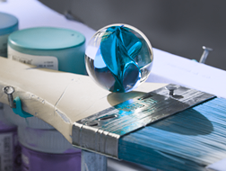
Data augmentation
Notes:
One neat property about working with a computer vision machine learning model is that if we’re careful, we can augment out data to provide more examples. If you’ve ever spent time altering photos digitally, we’re going to be using a lot of the same tools found in Photoshop or Gimp to expand our datasets.
For instance, even though I’ve changed the hue (color representation) in our marble photo, we can still tell that it’s a marble. Many machine learning frameworks already have tools in them to alter photos. We’re going to go over a few the tricks available to us.
As always, these aren’t tricks that will work in every situation. Depending on what we’re training our model to do, we might end up confusing it instead. Let’s say we’re making a model to identify flowers. Color would likely be critical information, so changing the color like I did above would end up being unhelpful.

Slide 38

Image Flipping
Horizontal Flip
Vertical Flip
Notes:
Let’s start with image flipping. In this case, we can imagine our photo is printed on a sheet of paper, and we’re just flipping that sheet of paper over.
Fair warning though flipping an image dataset might not always be appropriate. Fun fact: with a few exceptions, most words in American Sign Language can be mirrored depending on whether you’re right handed or left handed. https://www.handspeak.com/learn/index.php?id=98, so horizontal flipping is appropriate for our dataset. One the other hand, vertical flipping probably is not effective since people aren’t usually upside down when signing.
We can also think of our mnist dataset. If we both vertically and horizontally flip our sixes, they’ll look like nines, unnecessarily confusing our model.

Slide 39

Rotation
90⁰
45⁰
135⁰
0⁰
180⁰
315⁰
225⁰
270⁰
Notes:
A related one is rotation. We can still imagine our piece of paper, but now we’re rotating it. Is this one appropriate for American Sign Language?
Within reason. Just checking with my own posture, it’ pretty difficult to get into the exact same position 100% of the time, but we also might expect that signing at a 90 degree angle would be pretty out of place.

Slide 40





Zooming
Notes:
In fact, with many of these tools, it’s easy to go too far. Let’s take a look at zooming. If we think of our sheet of paper analogy, we can imagine we’re bringing the sheet closer to our faces.
Here we have our marble, and we’re zooming in on it more and more from left to right, top to bottom. For the first two or three, yeah, we can still tell that it’s a marble, but especially at the fourth one, we’re starting to lose too much information to be able to properly recognize it.
We usually only zoom into our pictures, because if we zoom out, we’ll need some sort of padding around the edges to keep our picture the same number of pixels.

Slide 41
Width And Height Shifting
Notes:
When we zoom in however, we can keep track of the pixels outside our field of view in order to do some shifting. Another word for this is translate. We’re just going to move our image left or right (horizontal) and up or down (vertical).
In the center here, we’ve zoomed in on our marble. Each of the surrounding pictures has the same zoom, but has been shifted either up, right, down, or left.

Slide 42

HomogRaphy
Notes:
All of these ways where we can warp an image in a physical dimension has an underlying concept called a homography. I’ve linked to an OpenCV article that explains the math behind it more, but here’s the quick version. We can imagine we have a camera and an image, and depending on our camera’s position and our image’s position, we can project our image in three dimensional space. We can do all this with some matrix multiplication, pretty neat!
https://docs.opencv.org/master/d9/dab/tutorial_homography.html

Slide 43

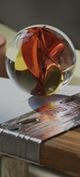

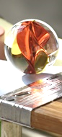
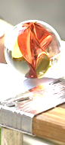
Brightness
Notes:
There are other things besides physically moving our image. We can adjust the pixel values as well. Here we have some examples of brightness. This is a great one to consider for real world images because unless the photos are professionally shot, it’s unlikely that lighting will stay consistent.
Just don’t go too crazy with the brightness adjuster. If it’s too dark or too bright, we won’t be able to see the image!

Slide 44
Channel Shifting
Notes:
Up until now, we’ve been working with greyscale images, but soon, we’ll be working with color. Colored images are 3d objects, the 3rd dimension now representing different color channels like Red, Green, and Blue (RGB). Each of these different channels has their own independent value, so for instance, if the red channel is 255, green is 0 and blue is 0, then the pixel will be red. Red 125, green 0, and blue 255 results in a purplish color. There are non-color channels too like alpha in RGBA, which represents transparency.
Channel shifting takes the pixels in each of these channels and adds or subtracts a random amount.

Slide 45
Model Deployment
… …
… …
(28, 28, 2)
Stacked Images
(28, 28, 2)
Stacked Images
(3, 3, 1, 2)
Kernels
(3, 3, 2, 2)
Kernels
(512)
Dense
(512)
Dense
(28, 28,1)
Image Input
(1568)
Flattened Image
Vector
(24)
Output Prediction
Notes:
Our model expects a particular input dimension, but it’s very possible that when we deploy our model for use in production (the real world), the format of the data we get from users is different then the format we trained on.

Slide 46
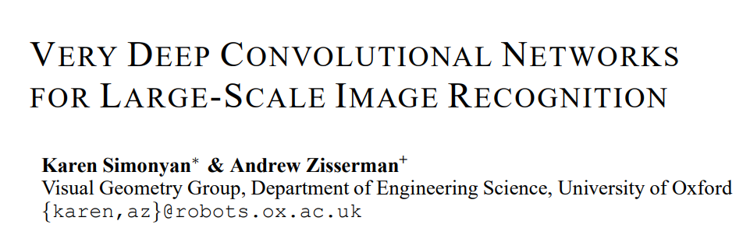
Pre-Trained Models
IM GENET
Notes:
The model we’ll be experimenting with is called VGG16 which was proposed in an appropriately titled paper, “Very Deep Convolutional Networks for Large-Scale Image Recognition”. It was a winning architecture for the 2014 ImageNet challenge. ImageNet is a database of millions of photos that have been labeled for thousands of categories including animals, food, trees, sports and people. Recently these object detection models perform better than humans, having over a 95% accuracy
VGG16 paper: https://arxiv.org/abs/1409.1556
ImageNet: http://www.image-net.org/
ImageNet tree traversal: http://imagenet.stanford.edu/synset?wnid=n03769722

Slide 47

Transfer Learning
… …
… …
(28, 28, 2)
Stacked Images
(28, 28, 2)
Stacked Images
(3, 3, 1, 2)
Kernels
(3, 3, 2, 2)
Kernels
(512)
Dense
(512)
Dense
(28, 28,1)
Image Input
(1568)
Flattened Image
Vector
(10)
Output Prediction
Notes:
Thankfully, the surgery we’re doing on our machine learning models is a lot easier than actual brain surgery. We’ll take a pretrained model and essentially cut the end off of it. We’ll use the top layers of the old model, and then build out our own new layers on the bottom.
Technically, we can slice and dice these layers any way that we want, but there is a practical reason for using the top of the old model instead of the bottom.

Slide 48
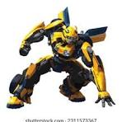
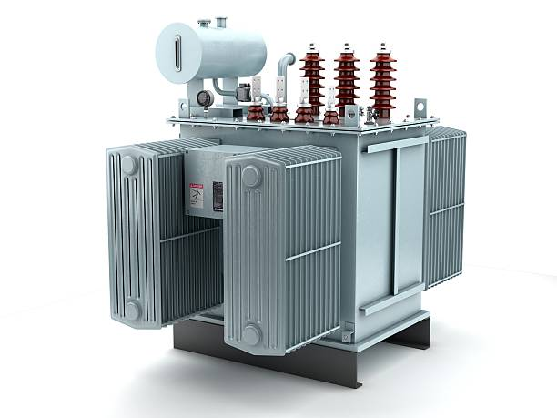
Transformer
GPT: Generative Pre-trained Transformer
Vision Transformer: DETR
Attention mechanism

Slide 49
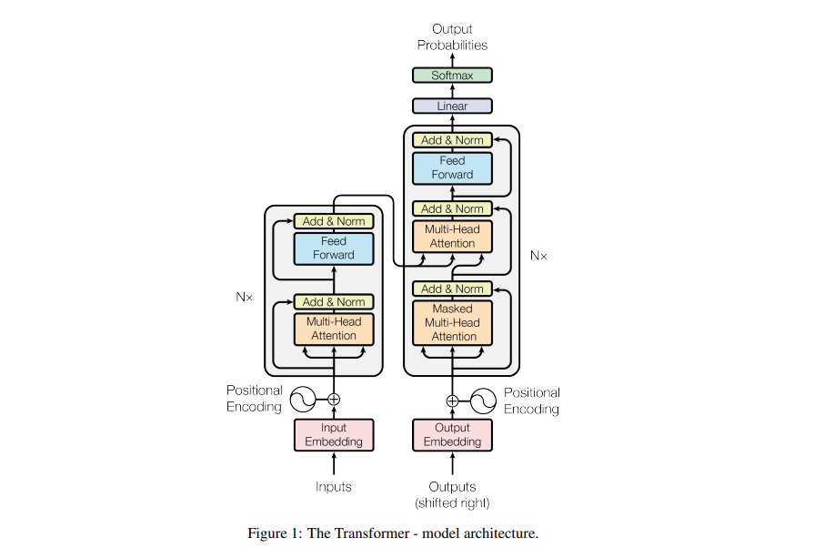
Vaswani, A. (2017). Attention is all you need. Advances in Neural Information Processing Systems.

Slide 50
GPT 3
Parameters 175 B
Dataset 45T
96 attention heads
2048 token size
Learn from their chief scientist: https://www.youtube.com/watch?v=kCc8FmEb1nY

